Slide 1
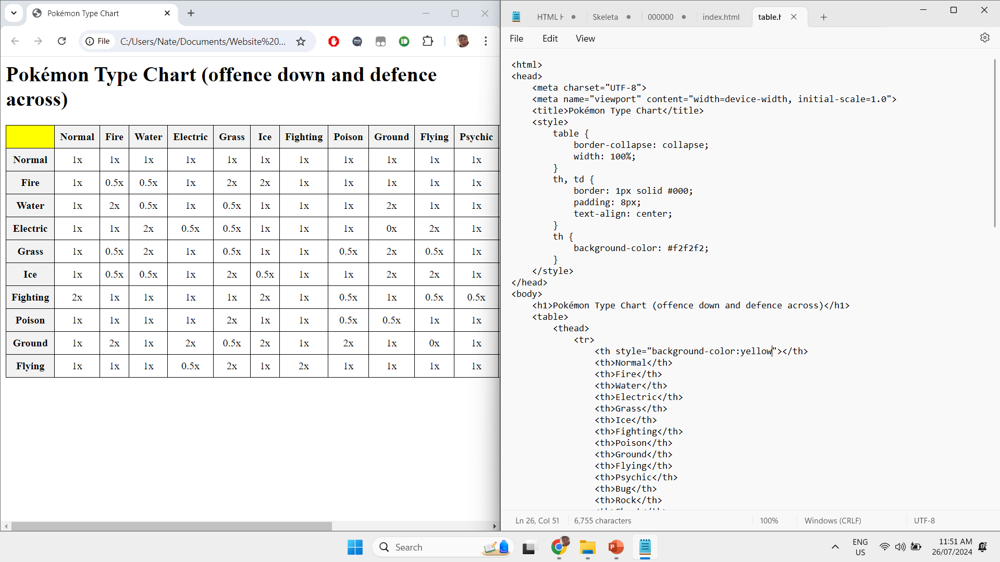
Introduction to HTML
Week 1: Learning the Basics

Slide 2
What is HTML
HTML (HyperText Markup Language) is fundamental in web development for several reasons. It provides the structure and content organization for web pages, allowing browsers to render and users to understand them effectively. As a standardized language, HTML ensures consistent appearance across different browsers and devices. Proper use of HTML enhances web accessibility, helping screen readers and other assistive technologies interpret and navigate web content, thus making the web more accessible to people with disabilities. It also plays a crucial role in SEO, as search engines use HTML to understand web page content, and proper use of tags can improve search rankings. HTML seamlessly integrates with other technologies like CSS for styling and JavaScript for interactivity, enabling the creation of complex, dynamic, and visually appealing websites. Additionally, HTML enables hyperlinking, allowing users to navigate between different pages and websites, and supports user input collection through forms. The evolution of HTML, with versions like HTML5, has introduced new features and capabilities, such as multimedia elements and graphics support, ensuring it remains relevant and capable of supporting modern web applications.

Slide 3
A step by step on how to make your first website
To begin creating your first website, you need to set up your development environment. You'll need a text editor where you can write your HTML code. Simple text editors like Notepad (Windows) or TextEdit (Mac) work, but more advanced code editors like Visual Studio Code, Sublime Text, or Atom offer features like syntax highlighting and error checking, which make coding easier. Additionally, you'll need a modern web browser such as Chrome, Firefox, or Safari to view and test your web pages.

Slide 4
Tags
HTML uses "tags" to define elements on a web page. Tags are enclosed in angle brackets (< >) and usually come in pairs: an opening tag (e.g., <p>) and a closing tag (e.g., </p>) with content in between. Here is a basic HTML template:
<html> <head> <title>My First Website</title> </head> <body> <h1>Welcome to My First Website</h1> <p>This is a paragraph of text on my website.</p> </body> </html>

Slide 5
My website ☺
Blaze6578.github.io

